Slide 1
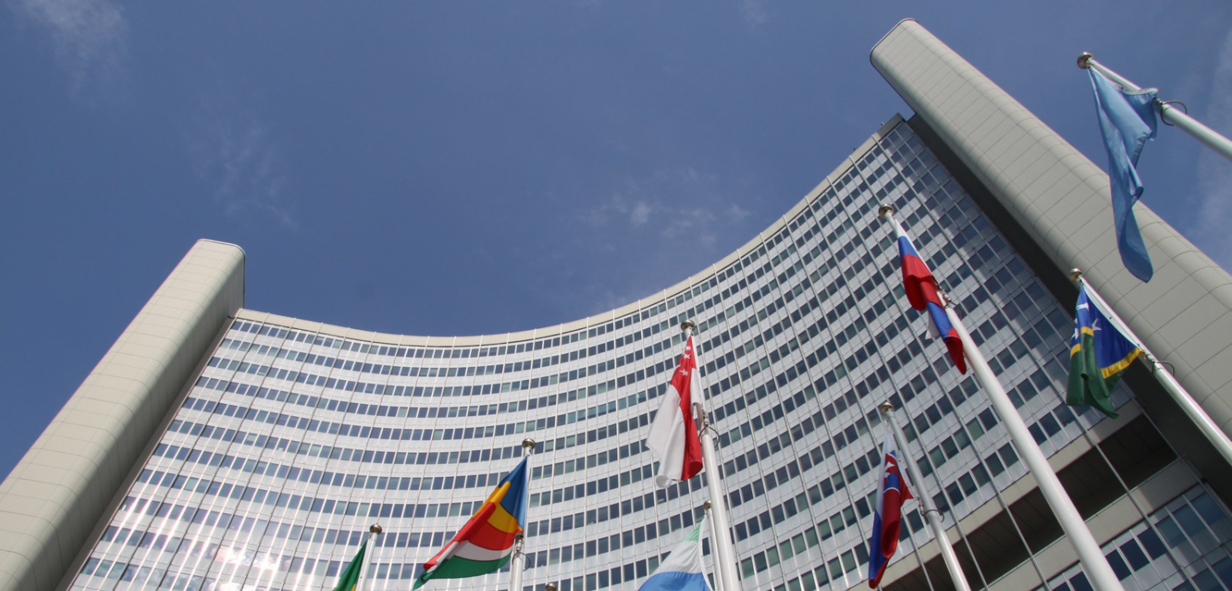
UNIDO – Private Sector Partnerships "Leveraging Businesses for Global Impact“

Slide 2
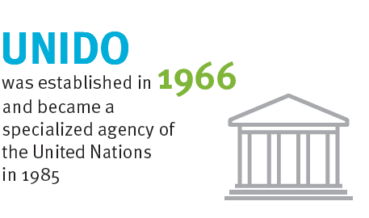
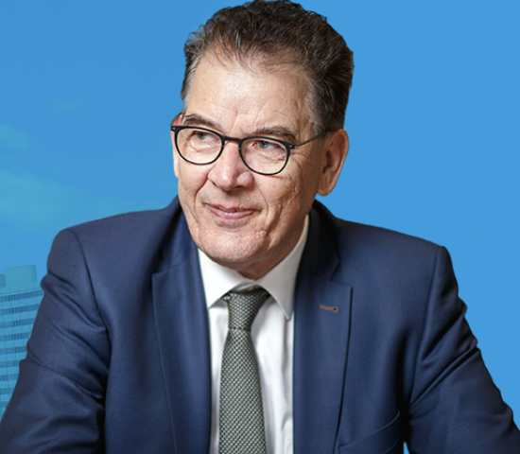
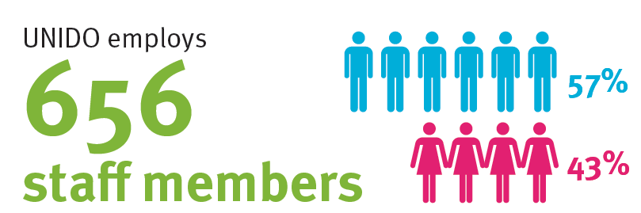
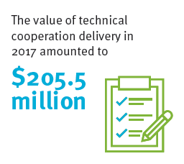
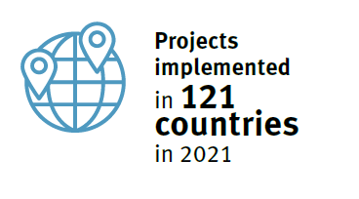
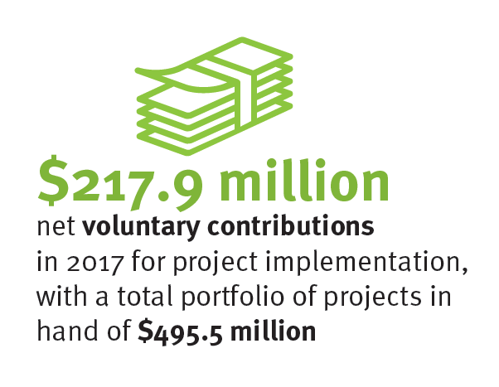
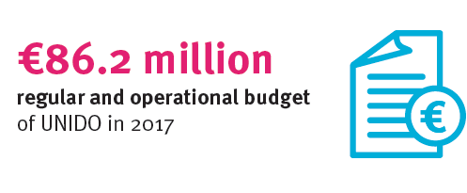
170
Gerd Müller
(Germany) was appointed as the Director General of UNIDO at the nineteenth session of the General Conference (December 2021)
(as at 31 December 2021)
682
57 %
The value of technical cooperation delivery in 2021 amounted to
43 %
As well as 1,691 consultants on ISA contracts from 135 countries (as at 31 December 2021)
$179.4
million
$197.3 million
€85.3 million
net voluntary contributions in 2021 for project implementation, with a total portfolio of projects in hand of $575.2 million
(expenditure of UNIDO in 2021)
(expenditure of UNIDO in 2021)

Slide 3
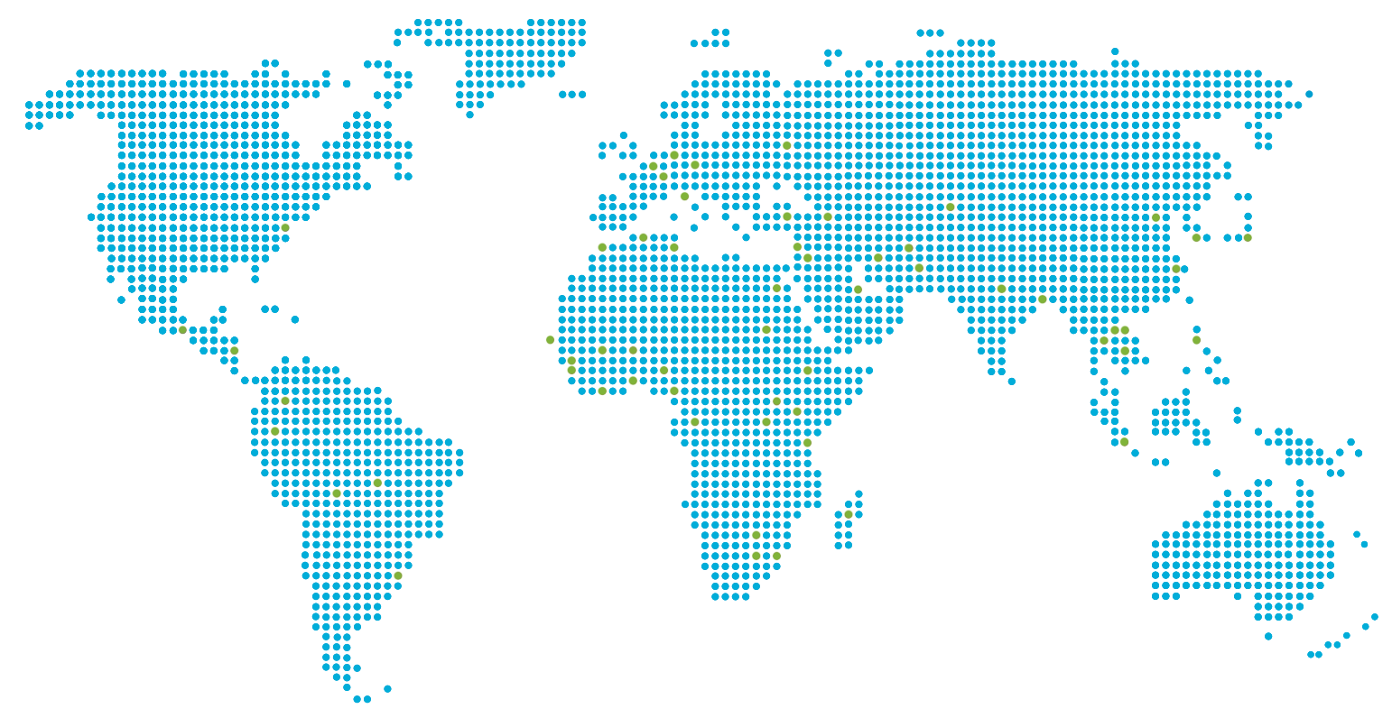
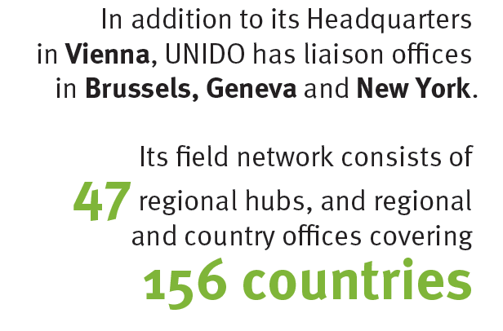
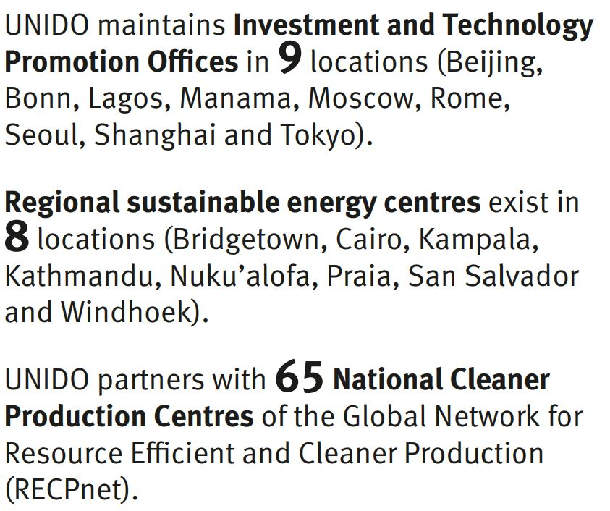
UNIDO Global Presence
48
UNIDO participates in 99 United Nations country teams (2021)

Slide 4
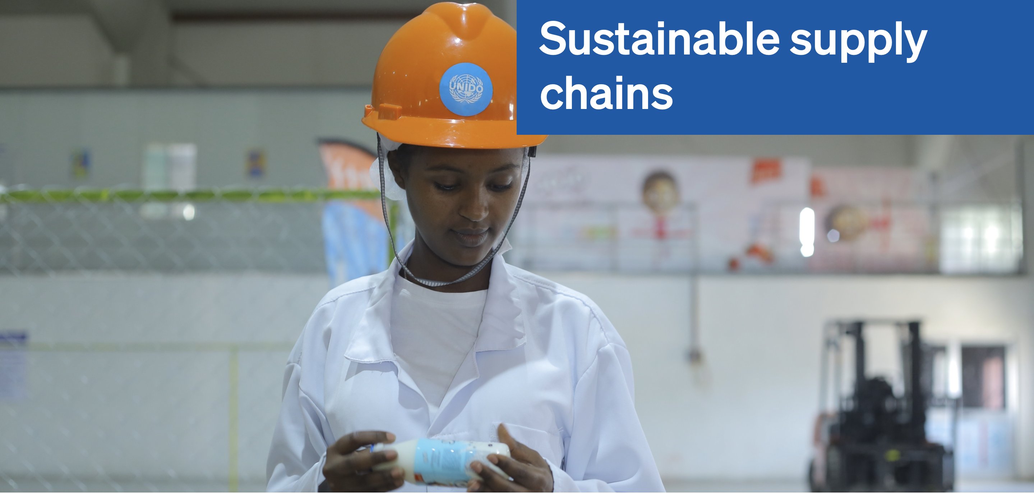
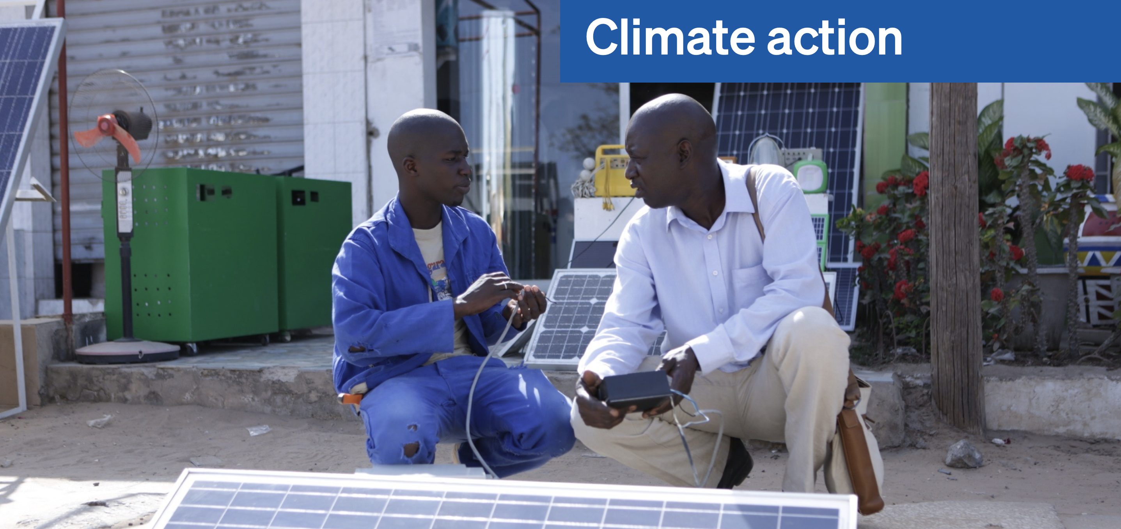
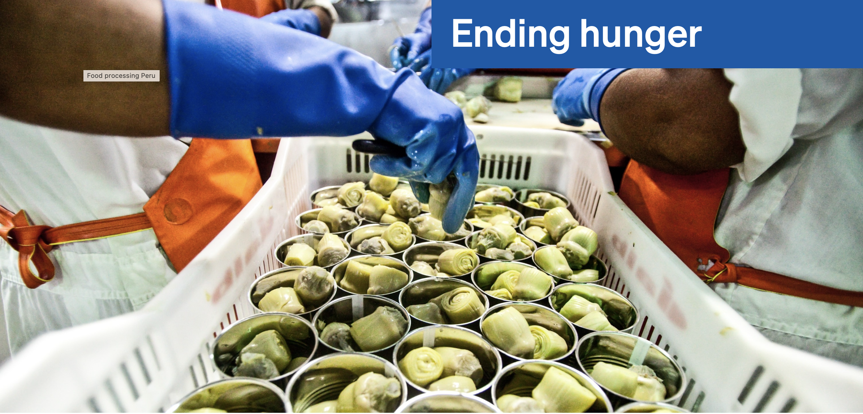
Cross cutting issues: women empowerment, digital transformation, partnerships, etc.
Director General Gerd Müller has set 3 priorities:
UNIDO helps developing countries integrate international value chains : support SMEs; improve trade competitiveness and market access; help countries and companies comply with international norms, standards and technical regulations (e.g. EU regulations on food safety, deforestation, CBAM, CS3D).
UNIDO helps developing countries and the private sector move towards the circular economy and decarbonization of industrial activities through energy efficiency and sustainable energy (renewables, green hydrogen, thermal, biomass, etc.).
UNIDO helps developing countries and countries in transition develop their agrifood systems, decrease post-harvest food losses, develop food preservation and conservation (storage, refrigeration, packaging, as well as value addition all long the value chains with quality control and food safety.

Slide 5
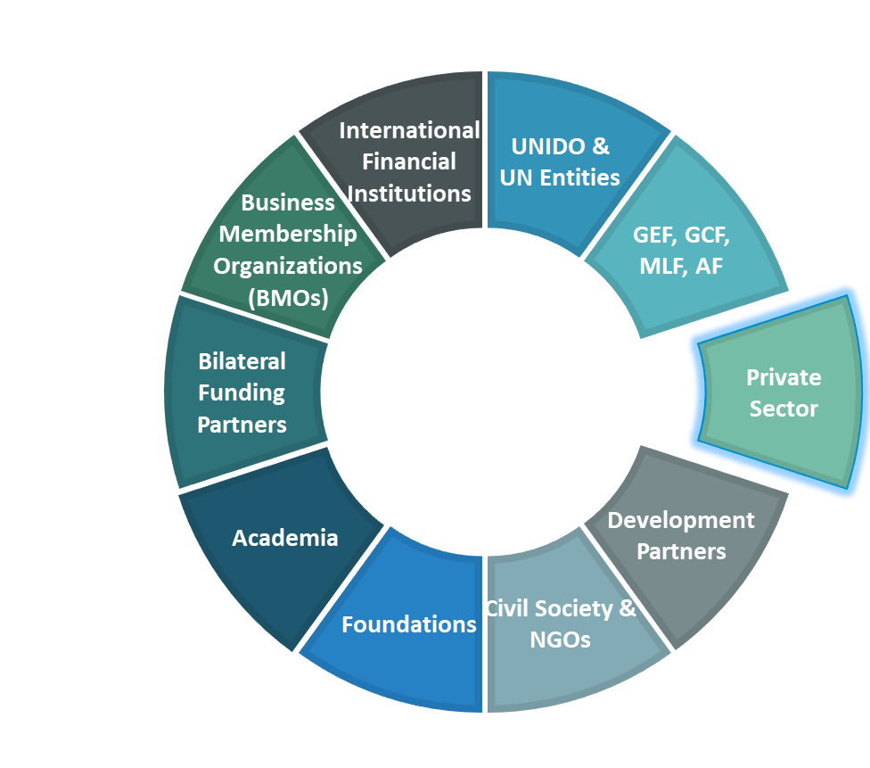
Why does UNIDO partner?
UNIDO Member States Priorities &
UNIDO's mandate on
INCLUSIVE AND SUSTAINABLE INDUSTRIAL DEVELOPMENT
requires the coordinated action of governments at all levels, international organizations, the private and public sectors, financial institutions, development banking, academia, and civil society.
NEED FOR PARTNERSHIPS
UNIDO POLICY ON PARTNERSHIPS FOR INDUSTRIAL DEVELOPMENT
UNIDO MTPF
Abu Dhabi Declaration, UNIDO GC 2019

Slide 6
WHY partner with UNIDO?
UNIDO partners to increase its developmental impact and to leverage resources and know-how towards Inclusive and Sustainable Industrial Development (ISID).
Market access and new business, by gaining understanding of the local context through field presence: 49 regional hubs, regional & country offices in 156 countries & working with 99 UN country teams.
Cutting-edge technology transfer, through capacity building and knowledge exchange opportunities, facilitated by UNIDO, acting as an honest broker.
Investment facilitation and prospects that drive market transformation and benefit all partners involved.
Networking and engaging in dialogue and collaboration with influential representatives from industry, governments and the international development community facilitated by UNIDO, acting as an impartial convener.
Achieving development impact, by potentially scaling-up and replicating successful initiatives for greater reach and influence.
The private sector partnerships are guided by transparency, integrity, compliance with environmental, social and governance standards, equity and respect.

Slide 7
HOW to partner with UNIDO?
Events & Platforms
Opportunities to discuss, share expertise, and generate new solutions.
Projects
Specific duration, geographical location & funding for a common goal.
Partner Expert Programme (PE)
Qualified experts sponsored by Member States or partner institutions gain experience at UNIDO through projects and assignments.
Data & Policy Dissemination
Joint publications to disseminate knowledge and best practices.
Investment and Technology Promotion Offices (ITPOs)
Matching investors and technology suppliers from developed and developing countries.
Procurement
UNIDO procures goods and services from the business sector (commercial relationship).

Slide 8
SLOVENIA - UNIDO
PARTNERSHIP

Slide 9
How to engage with UNIDO? Model: collaboration with Member State and Private Sector acts as a subcontractor
Projects
Specific duration, geographical location & funding for a common goal.
TC projects - collaborate to improve people’s lives and contribute towards ISID trough technical cooperation projects aligned with all the involved parties interests and mandates.
Donor/
Member State/
Slovenia
UNIDO / development partner
WHAT?
Technical cooperation project: co-created and co-designed and aligned with Slovenian government and UNIDO’s mandates and interests. Under the project a subcontract to private sector is foreseen with the geographical limitation to Slovenian companies.
WHY?
- Tool for implementation of Slovenian Development Cooperation Strategy/Policy.
- Achievement of SDGs.
- Facilitate market access and new business generation for Slovenian private sector.
- Achievement of SDGs.
- Achievement of UNIDO mandate.
- Service to the Member States.
- Knowledge and technology exchange.

Slide 10
Entities: Technology Park Ljubljana, SIQ
Focus area: Promoting innovation ecosystem
Country: Azerbaijan
How? (modality): Establishment of Digital Education and Innovation Centre
Coordination & TA
Knowledge, experience and best practices
Technology Park Ljubljana
UNIDO
Digital Education and Innovation Centre established
SIQ
Funding
Co-ordinating agency
SLOVENIA
AZERBAIJAN
Notes:
SIQ - Slovenian Institute of Quality and Metrology
Objective:
Promoting innovation ecosystem building with a focus on StartUp and ScaleUp, skills upgrading, leveraging opportunities and addressing challenges of the 4IR for enhancing SME competitiveness and improved market access.
Output:
Digital Education and Innovation Centre established
Main Activities:
Establishment of an e-learning platform
Developing e-learning toolkits
Organization of study tours
Training workshops

Slide 11
PROCURMENT

Slide 12
BUSINESS OPPORTUNITIES WITH UNIDO
Around $200+ million worth of Technical Cooperation procurement annually
UNIDO procuring a variety of goods, services and works from a wide range of sectors
UNIDO has 3000 suppliers internationally
Opportunities for manufacturers, companies and academia, etc.

Slide 13
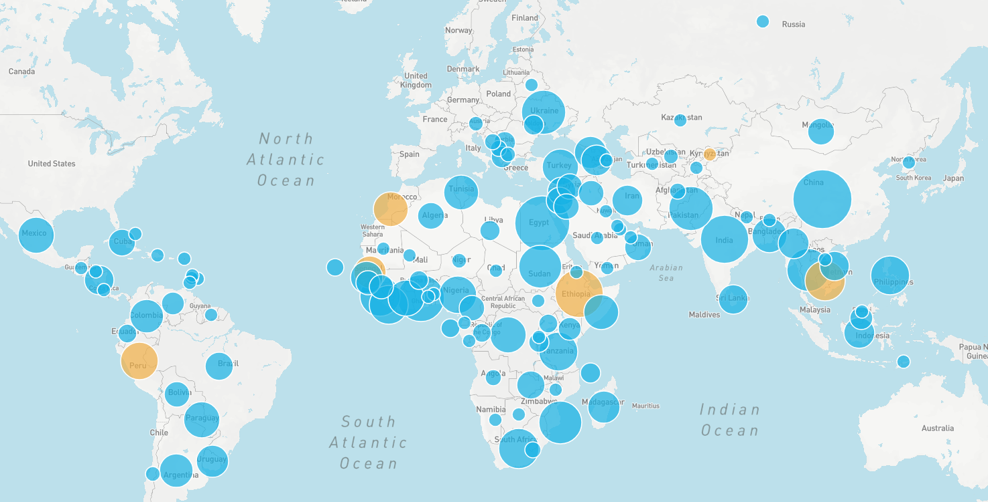
WHERE WE DO BUSINESS
UNIDO TC Projects Globally

Slide 14
PROCUREMENT PRINCIPALS
Best interest of UNIDO
Fairness, Integrity and Transparency
Effective
Competition
Best Value for Money
Meeting UNIDOs organizational goals and objectives
Equal opportunities for bidders to participate
Open Competition
Clear rules and processes
“Technically Acceptable, Most Competitive”

Slide 15
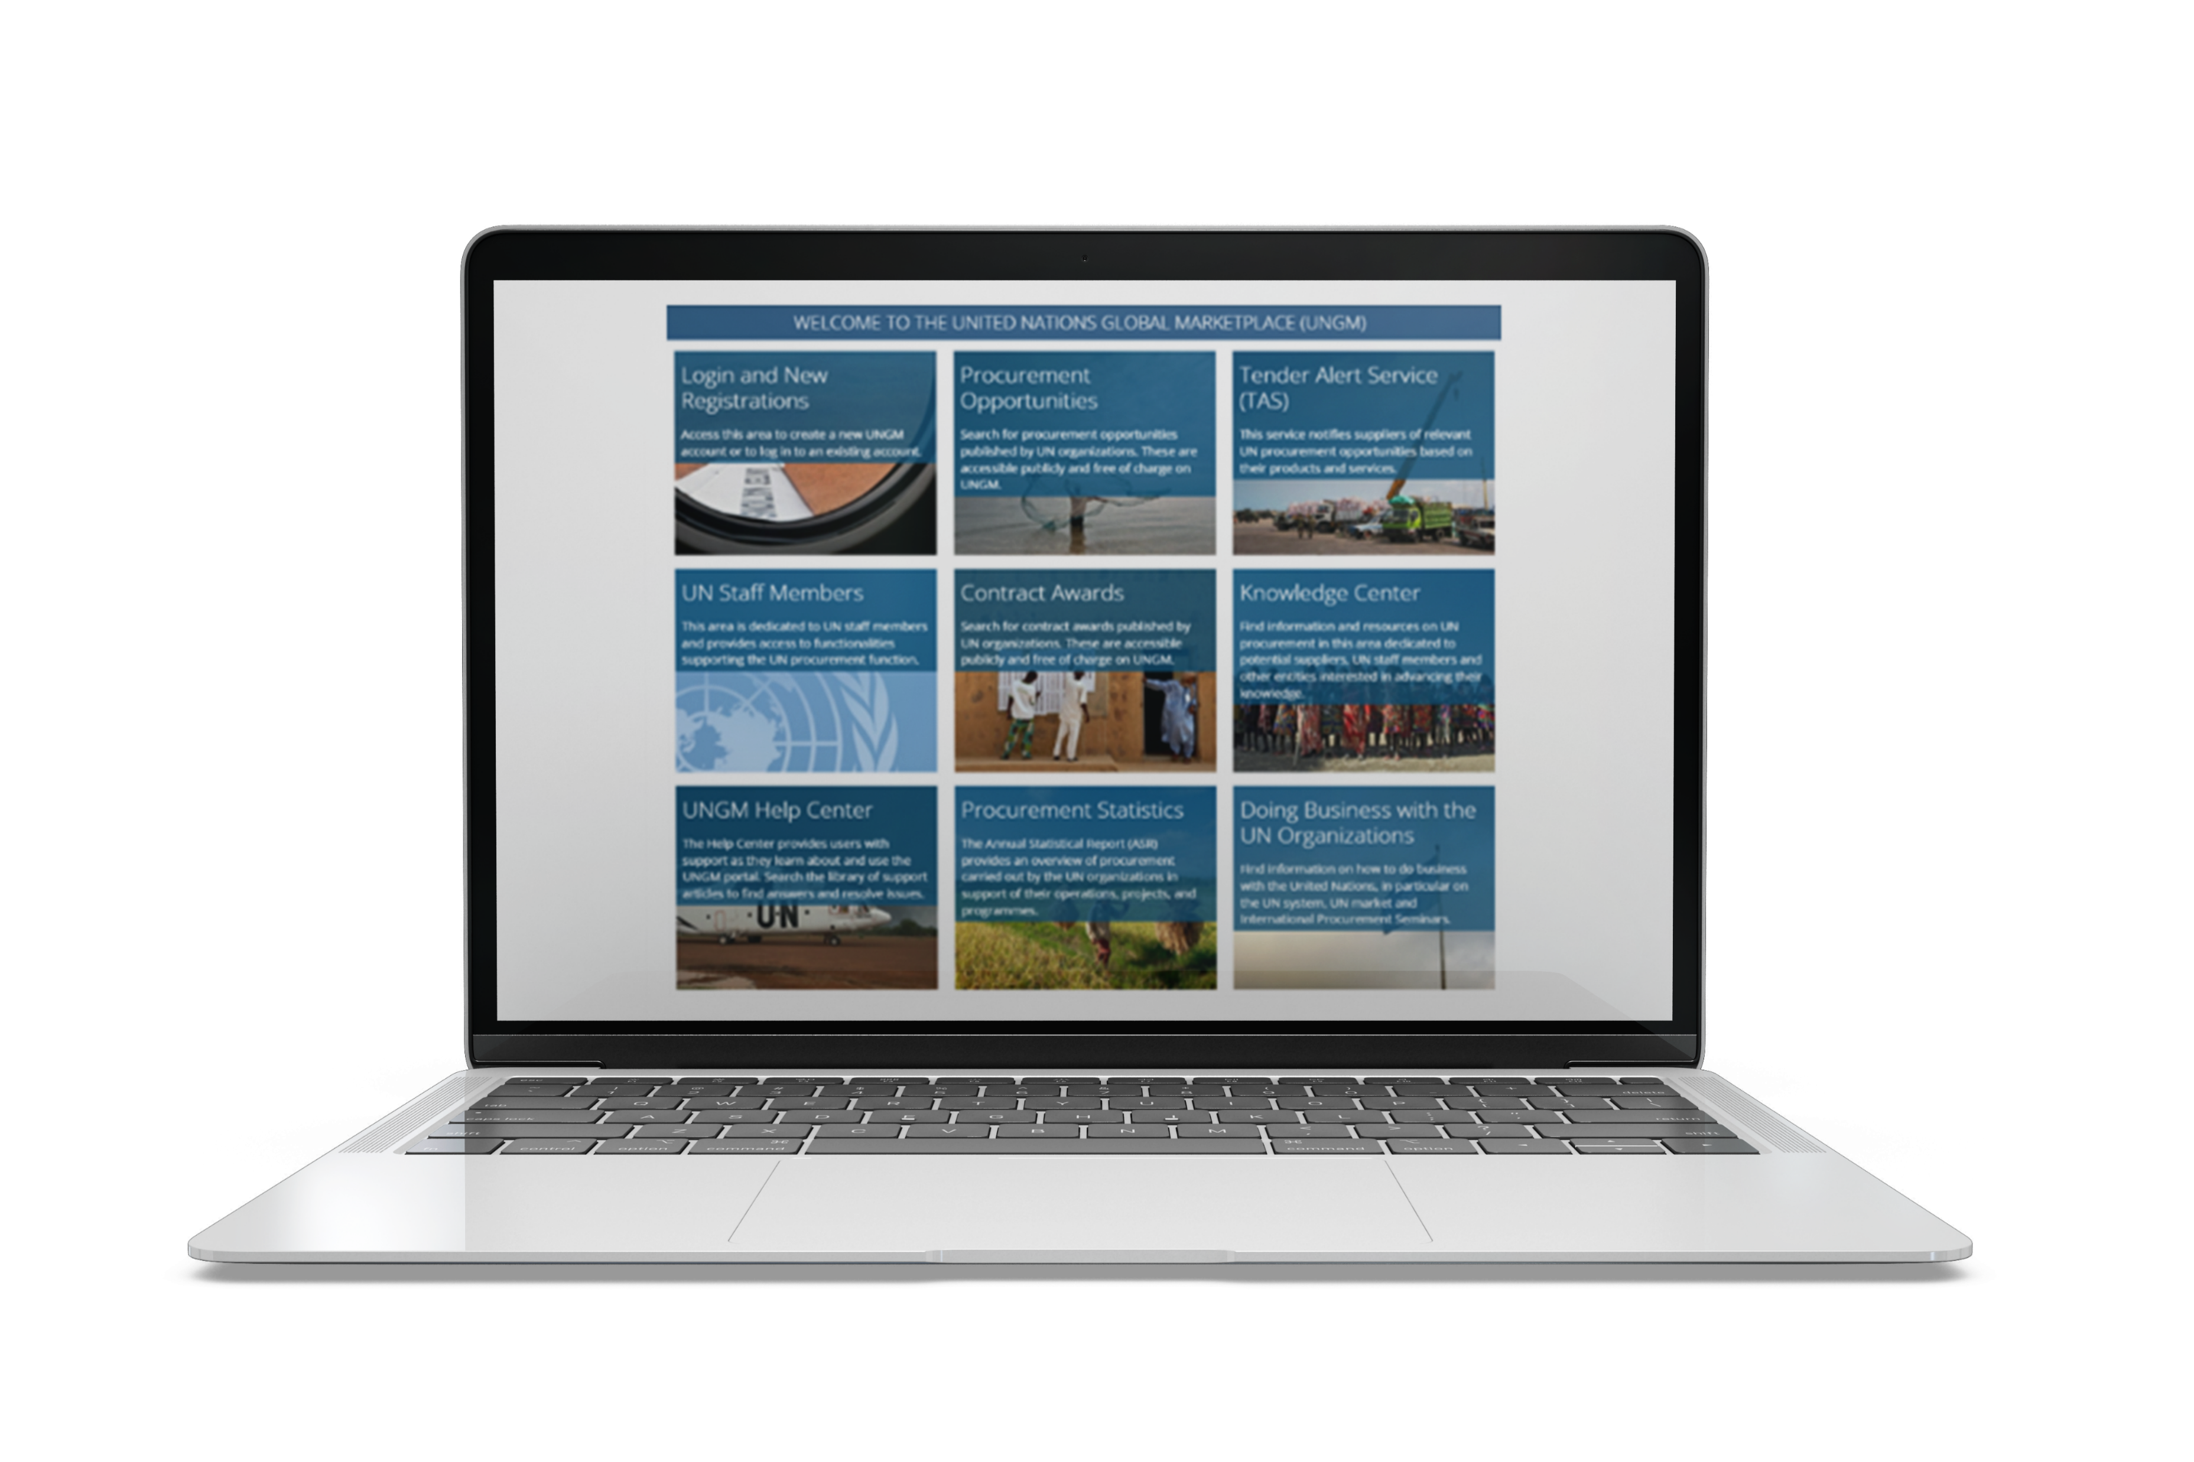
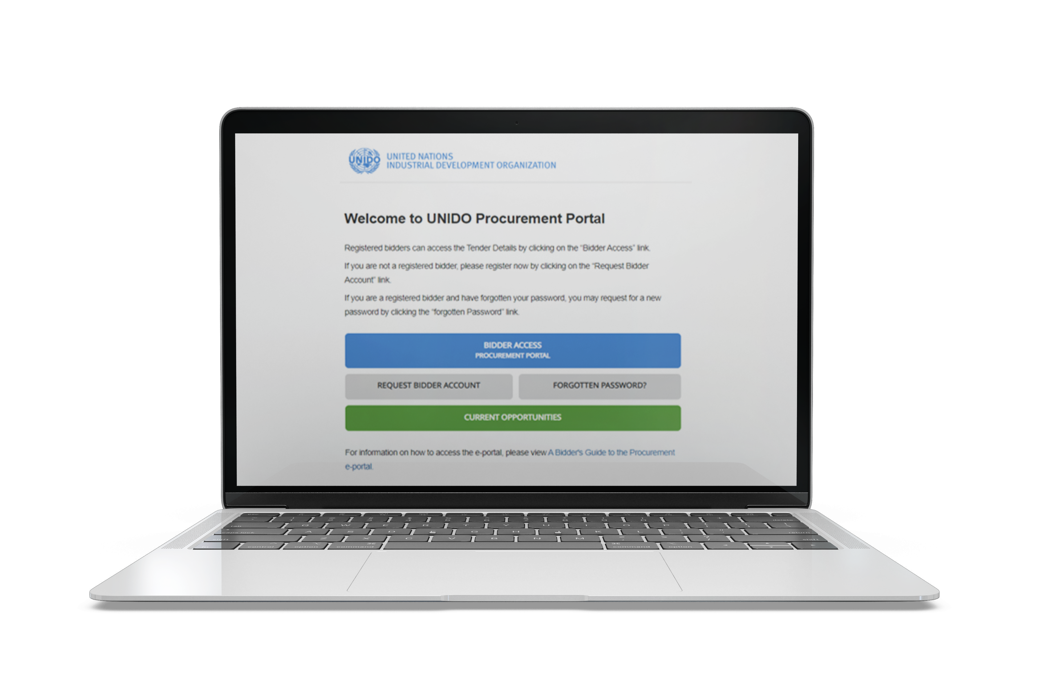
HOW TO REGISTER AS A VENDOR WITH UNIDO
Register on UNIDO and UNGM platforms
Participate in UNIDO tenders
Understand UNIDO’s requirements
3
1
2
UNIDO Procurement Portal
United Nations Global Market
www.ungm.org
www.procurement.unido.org
Notes:
Suppliers who wish to do business with the UN must register with the UN Global Marketplace (UNGM) or with specific UN agencies. Registration allows suppliers to participate in UNIDO and general UN procurement opportunities and receive notifications about upcoming bids and tenders.

Slide 16
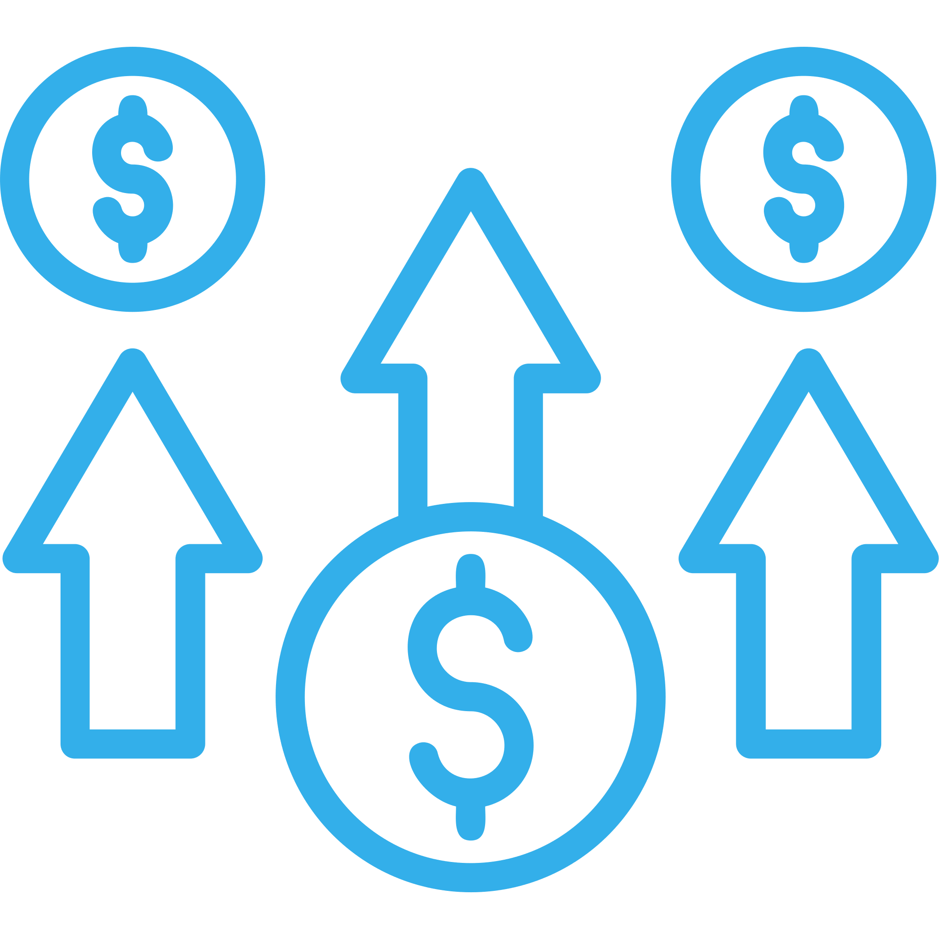
POTENTIAL CHALLENGES FOR BIDDERS
Compliance requirements
08
01
Order size not big enough? Not profitable?
UNIDO not well-known in the business community?
07
02
Products too advanced, therefore too expensive? Don’t meet international standards
Typical Challenges
Bidders
Face
06
03
Complex regulations and procurement procedures? Language barrier?
Service-orientation difficult to handle? Remote locations.
05
04
Cultural and logistical - locations “tough places” with challenges of transportation?
Heightened and intense competition

Slide 17
Thank you! partnerships@unido.org

Slide 18
Current portfolio

